Slide 1
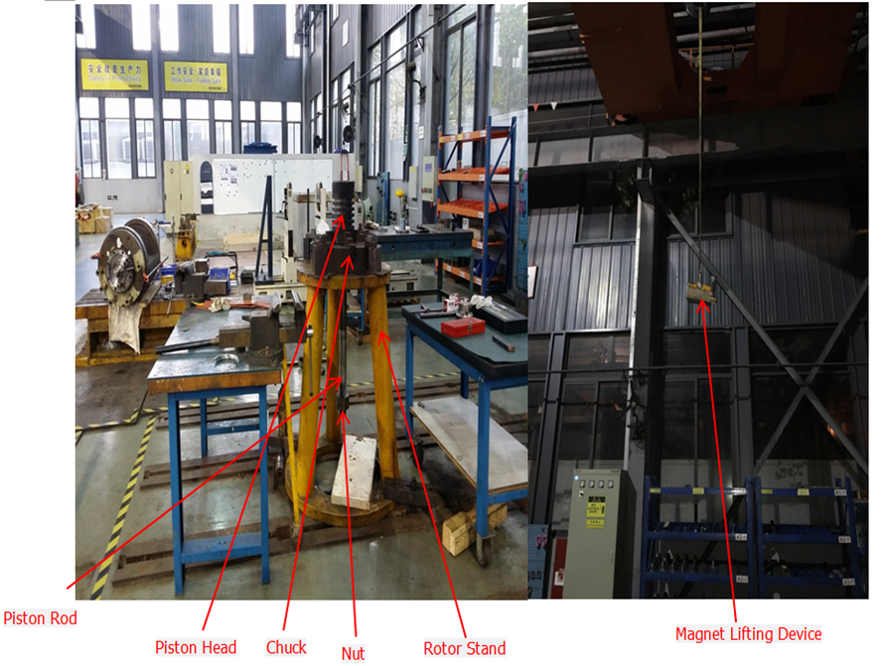
HS&E INCIDENT BULLETIN |  | 2nd half year 2016
Shanghai, China | Type of incident (Finger Fracture – Material Handling)
Summary:
The injured employee was working alone, lifting a piston assembly (70 kg/154 lb) placed on a vertical rotor stand using a magnetic lifting device (lifting capacity 300 kg/661 lb) attached to a 5-ton overhead crane. During the lift, his right hand was controlling the crane pendant and his left hand was holding the piston to align the piston rod (with nut) to pass through the chuck bore. As the piston assembly was being lifted up, the piston rod nut (used for protecting the thread) stuck under the chuck resulting in the piston detaching from the magnetic lifting device. At this point the employee’s left hand was still on the piston; the falling piston assembly pinched his hand against the chuck. The employee was given first aid and later received medical treatment at the hospital. He sustained a fracture to his left thumb and a laceration on his palm.
Root Causes: | Actions Taken Thus Far: Next Steps
Incorrect method of removing piston nut. Incorrect lifting method of piston assembly, and risk assessment (JSEA) was not performed for the lifting task. Critical lift checklist was used but failed to identify the risk. Operator controlled the crane with one hand and used the other hand to hold the piston to align piston rod nut to pass through the chuck bore. | Re-train all employees on Global Crane and Lifting Policy List all critical lift activities and critical lifts can only be performed if a job-specific critical plan is developed and discussed with employees before the lift. Shop supervisor to lead HIRA/JSEA review before start of each shift. Assess key technical competency for shop employees. Review with management and prepare plan to close gap.

